Slide 1
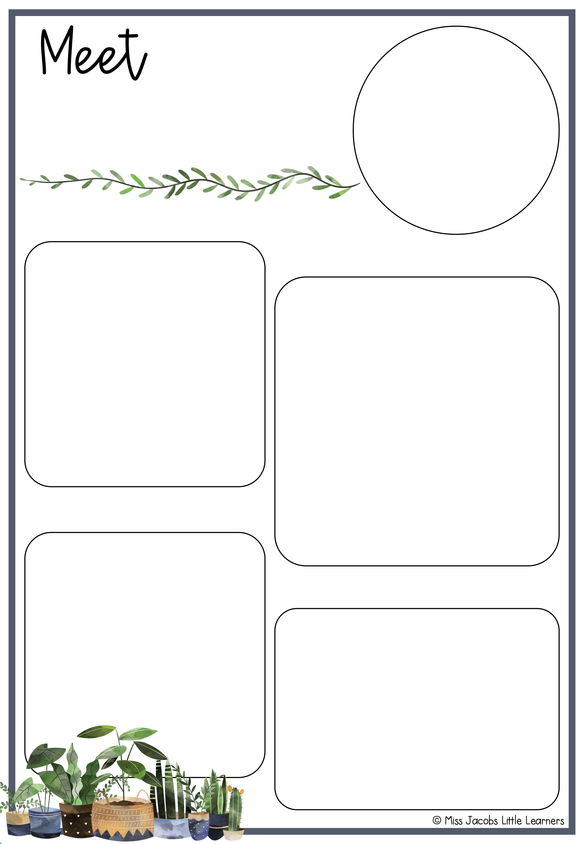
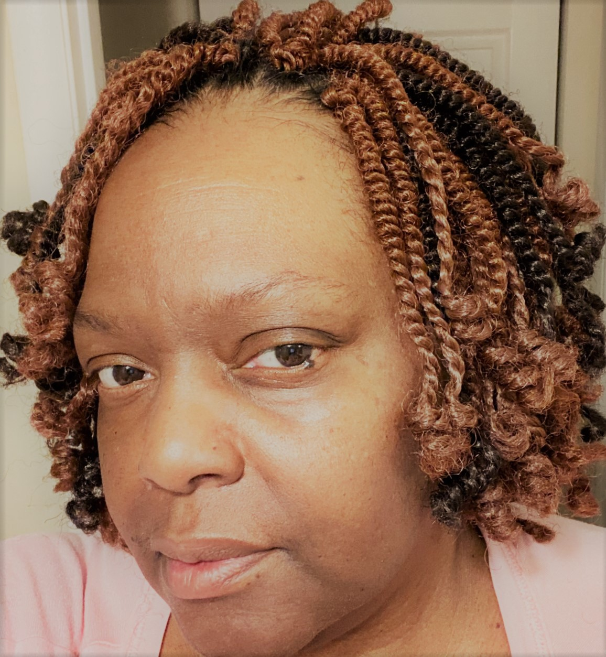
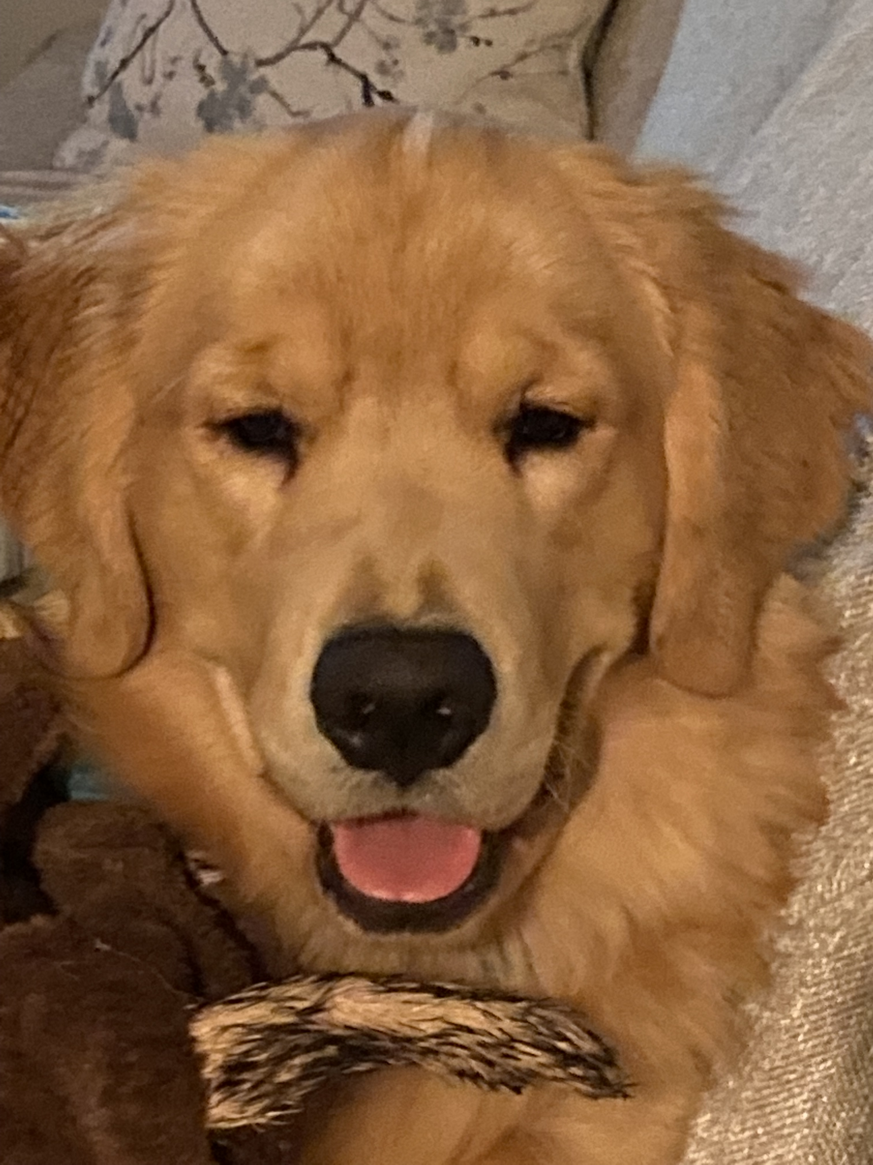
Mrs. Michelle Brady
About Me
Fun Facts
Hello I am Michelle Brady, the
5th grade ELA and Science
Teacher at BCE. I have been
A Roadrunner for 16 amazing
Years. My husband, Thomas
and I have been a resident of
Augusta for 25 years. We are
also the super proud parents of
Walker, the Golden Retriever.
My favorite colors are green, brown, and blue.
My favorite author is Michael Eric Dyson
My favorite sport’s team is the Golden State Warriors
My favorite past time is playing with Walker!
Contact
Class Dojo
https://www.classdojo.com/invite/?c=CEUBZ88
BCE’s Number: 706-796-4955
Email: Bradymi@Richmond.k12.ga.us
BCE Theme
G.A.M.E.S.
Goals and Motivation Equal Success

